Slide 1
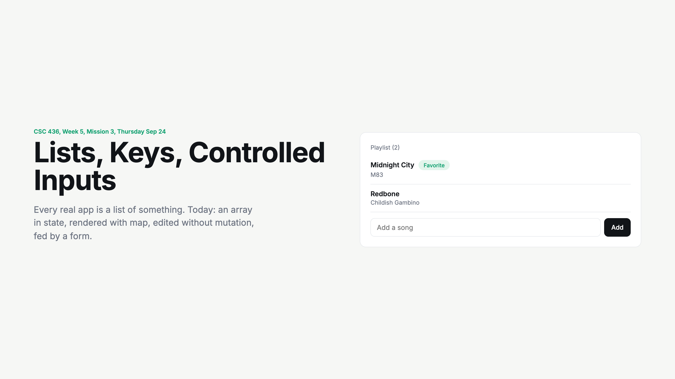
Notes:
Add a song from the room. Ask: what changed when I hit Add? An array in state got longer and React drew a new row. That is the whole day.

Slide 2
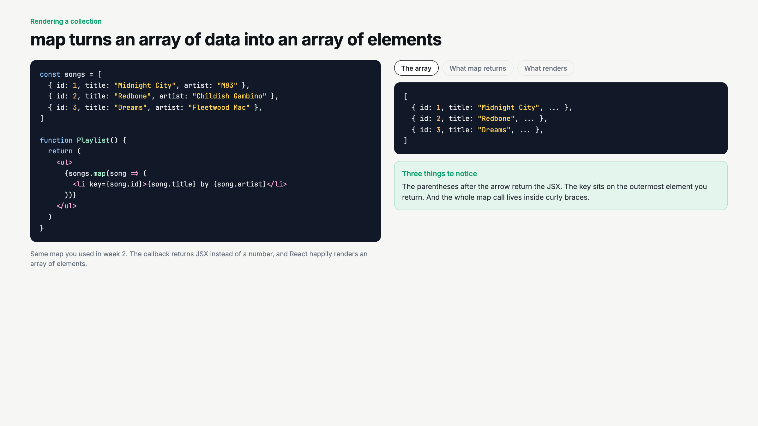
Notes:
Click through the three tabs slowly. Data, elements, pixels. Point out the parentheses after the arrow, and that key goes on the li.

Slide 3
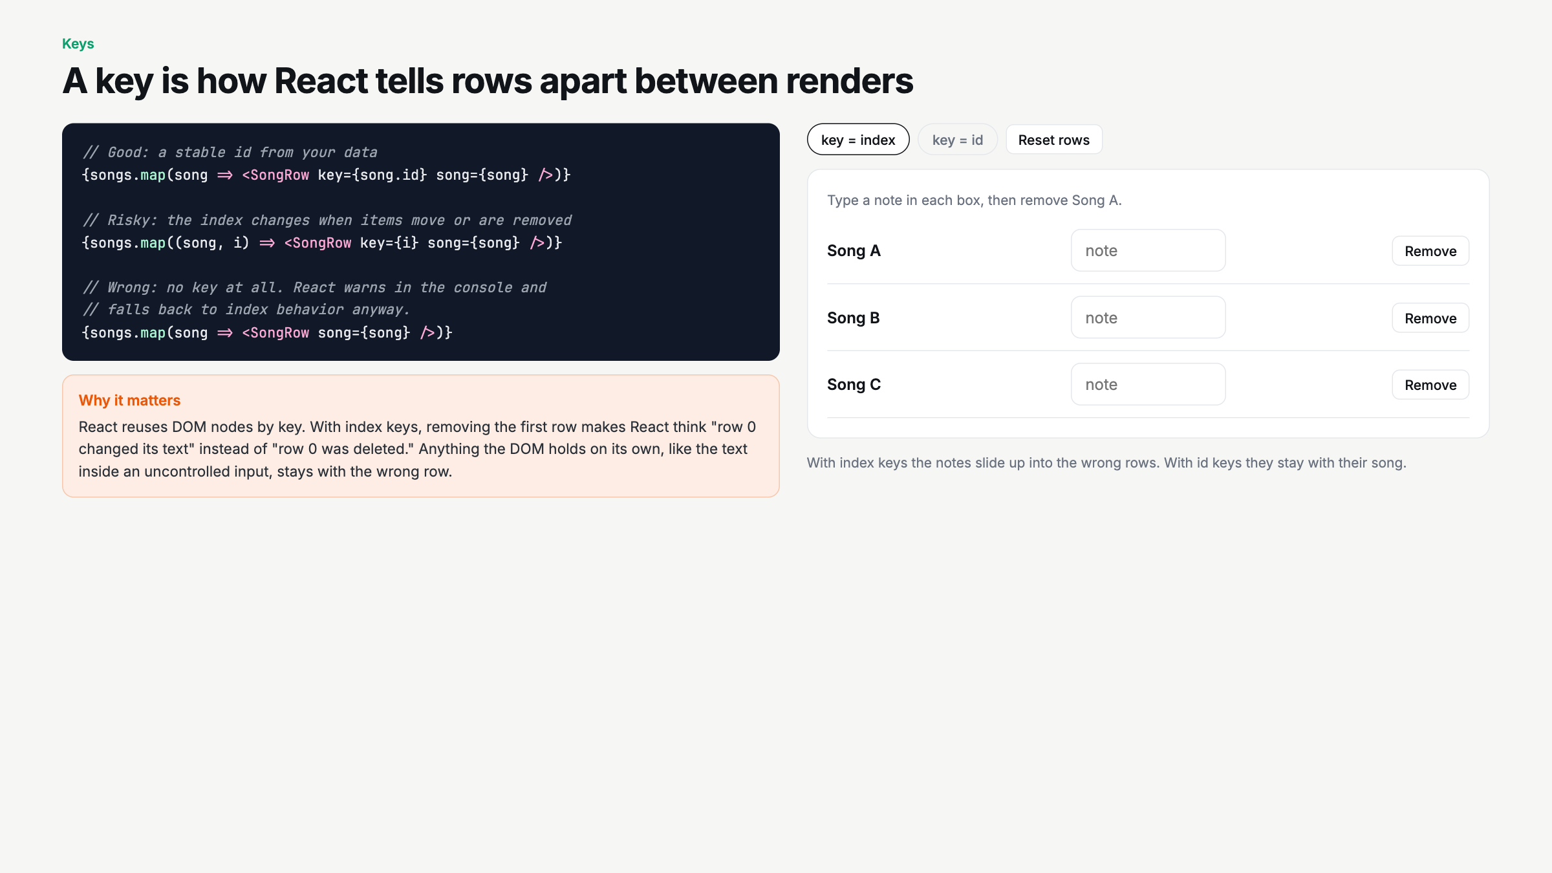
Notes:
Type a note in all three boxes with index keys, remove Song A, watch the notes shift. Switch to id keys, repeat. This demo sells keys better than any explanation.

Slide 4
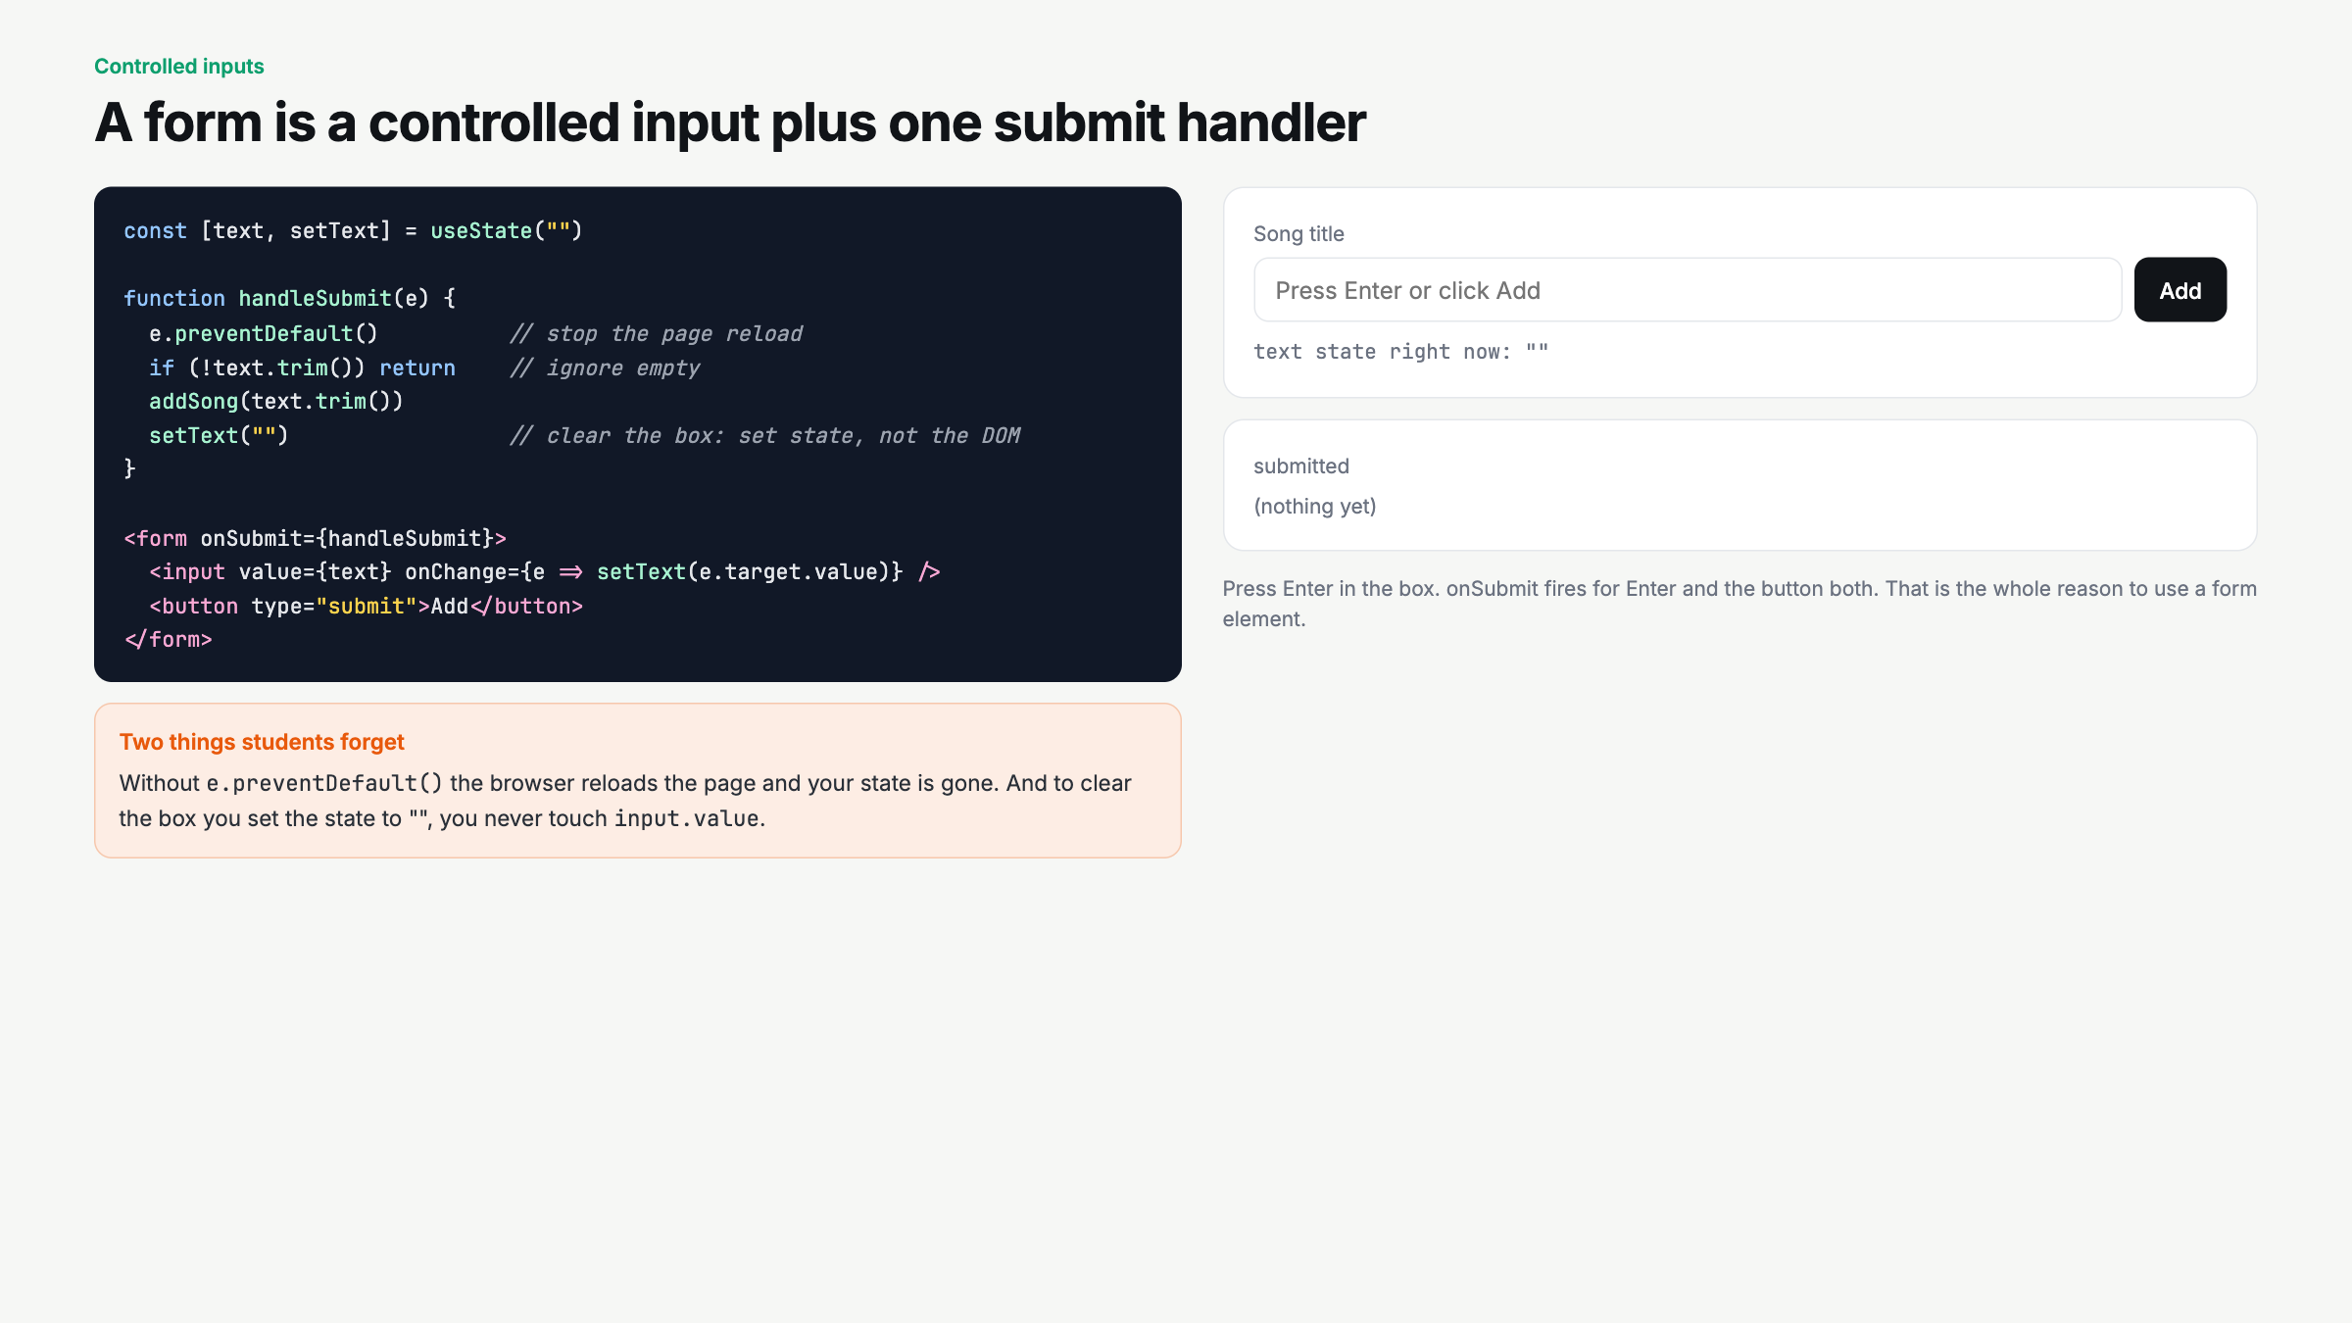
Notes:
Deliberate mistake beat: delete e.preventDefault live and hit Enter. Page reloads, state gone. Put it back.

Slide 5
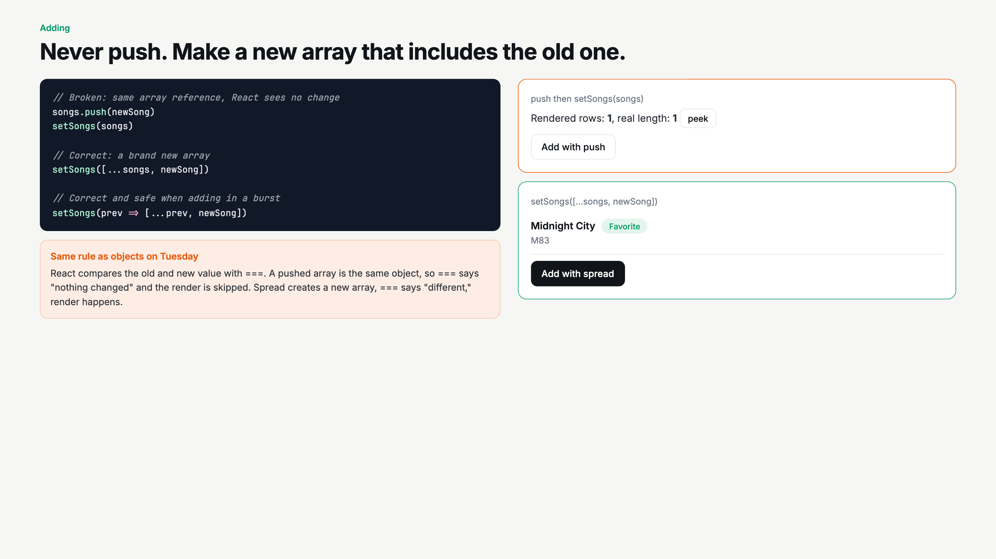
Notes:
Push first, peek, show the real length grew but nothing rendered. Then spread. Tie back to Tuesday's bug 2: same reference, no render.

Slide 6
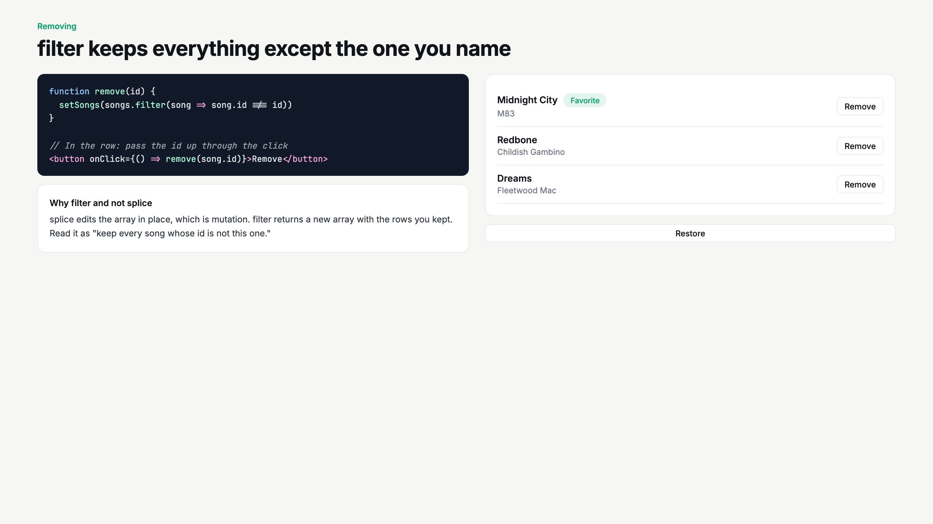
Notes:
Read the filter line out loud as English: keep every song whose id is not this one.

Slide 7
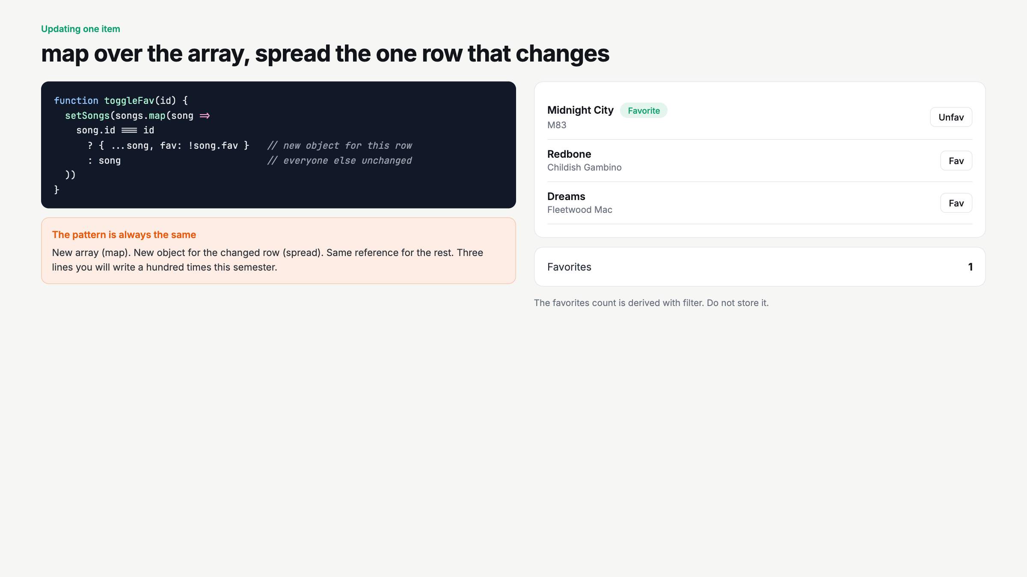
Notes:
This is the one they will get wrong on the assignment. Write the three-line pattern on the board and leave it there.

Slide 8
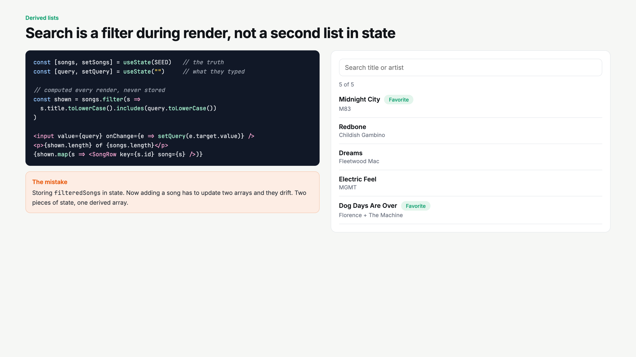
Notes:
Ask: how many arrays are in state here? One. shown is not state. Same as subtotal on Tuesday.

Slide 9
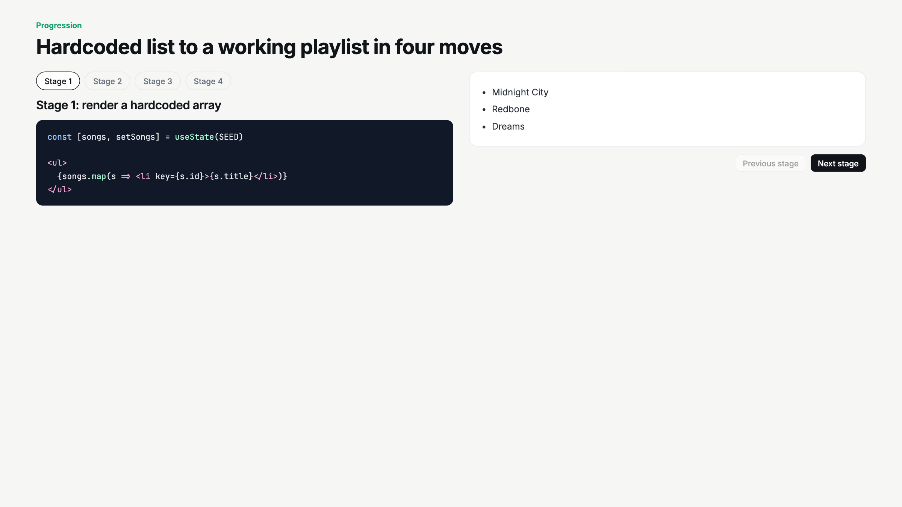
Notes:
Live-code script. Stages 1 to 4 in order. At stage 3, use splice on purpose, watch nothing happen, then filter.

Slide 10
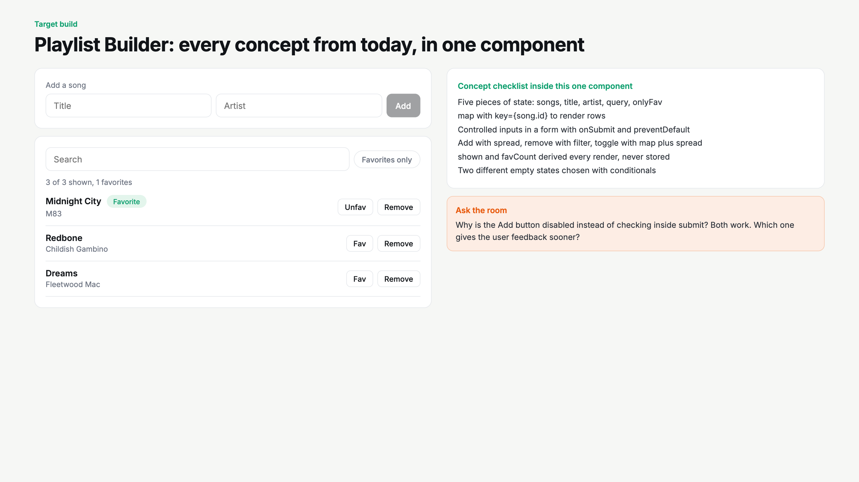
Notes:
Add a song from the room, favorite it, search for it, remove it. Walk the checklist. This is the assignment target.

Slide 11
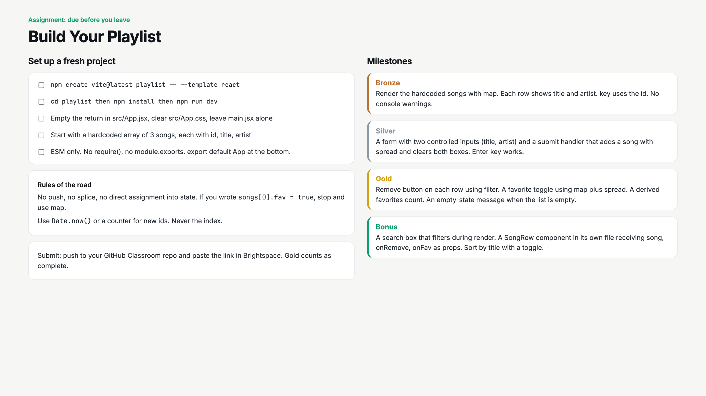
Notes:
Read the rules of the road out loud. Start a 25 minute timer. Circulate for index keys and mutation.

Slide 12
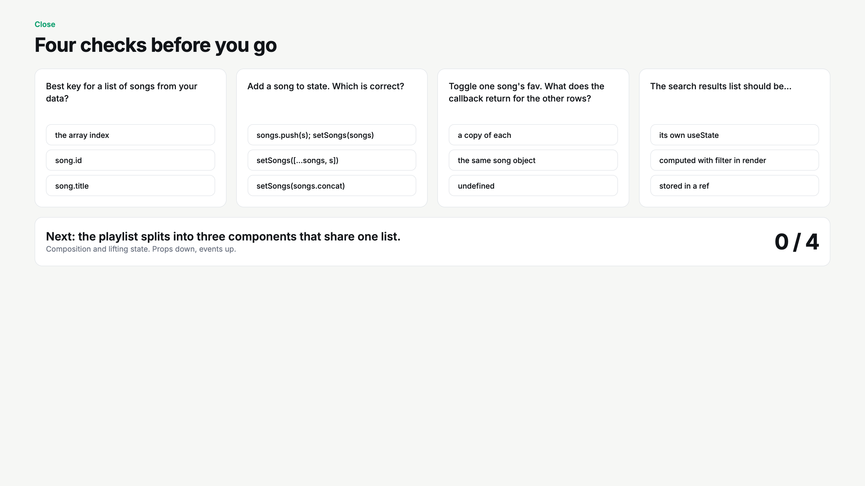
Notes:
Hands up per question. Q3 catches people who copy every row. Tease next week: SongRow becomes its own component with callbacks.

